Slide 1

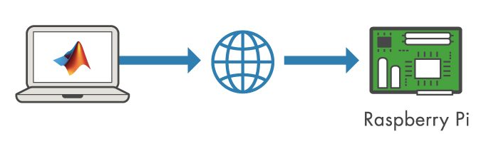

Webinar on Using MATLAB and Simulink with Hardware
By Deepak Guru Ganesan,
MATLAB Student Ambassador at Chalmers

Slide 2
Agenda
Who am I?
MathWorks
Hardware development
Ways of development–Raspberry pi and Software Setup
Basic tutorials and demos
Courses available to Students
MATLAB Central community

Slide 3

Who am I?
MATLAB Student Ambassador @Chalmers.
MSc in Complex Adaptive Systems
Join the facebook group MATLAB@Chalmers http://tiny.cc/matlabchalmers
Join the Instagram page of MATLAB Chalmers https://instagram.com/matlab_chalmers?igshid=xw5gw0v1crv2
Any event suggestions? Email me: deepakg@student.chalmers.se

Slide 4
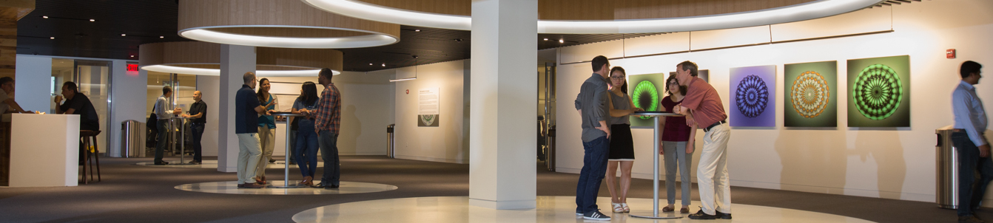
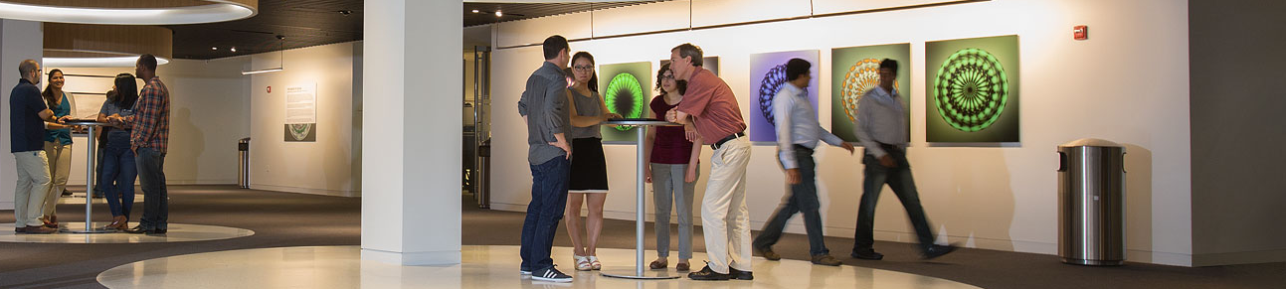

The leading developer of mathematical computing software for engineers and scientists.
Notes:
MathWorks is the leading developer of mathematical computing software
Engineers and scientists worldwide rely on our products to accelerate the pace of discovery, innovation, and development

Slide 5
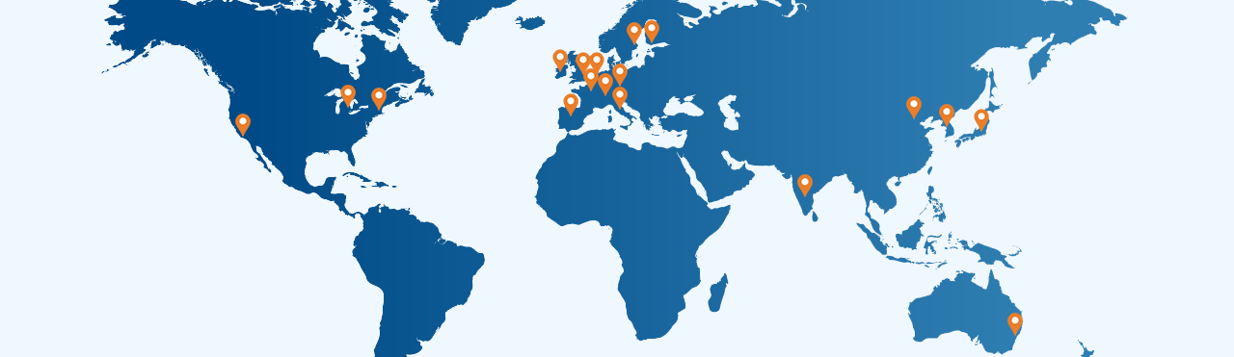





MathWorks Today
Headquarters
Natick, MA USA
Europe
France
Germany
Ireland
Italy
Netherlands
Spain
Sweden
Switzerland UK
Asia-Pacific
Australia
China
India
Japan
Korea
North America
United States
3 million+
users
4000+ staff
$950 million
Privately
held
in more than 180 countries
in 31 offices around the world
in 2020 revenues with 60% from outside the US
and profitable every year
Notes:
Over 3 million people in more than 180 countries use our products
MathWorks is a global company with over 4000 staff members in 31 offices
We’re profitable; our revenues last year exceeded $900 million, with 60% coming from outside the US

Slide 6
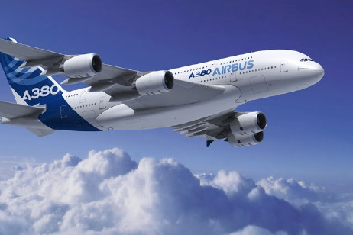
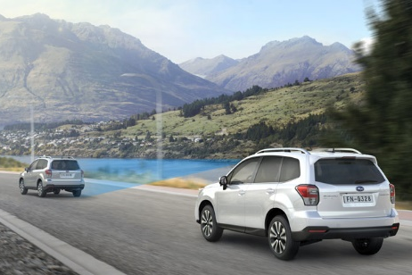
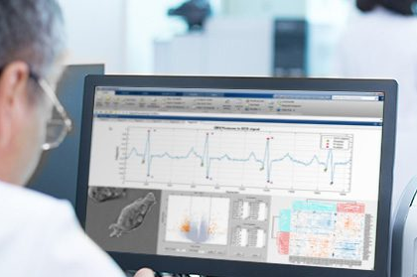

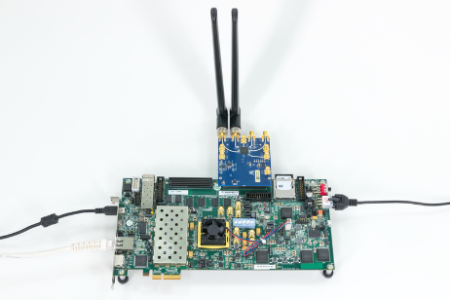
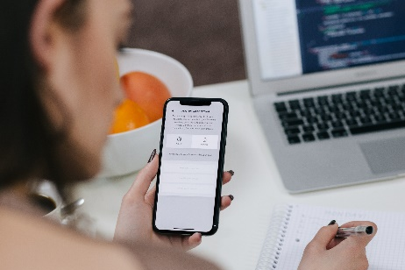
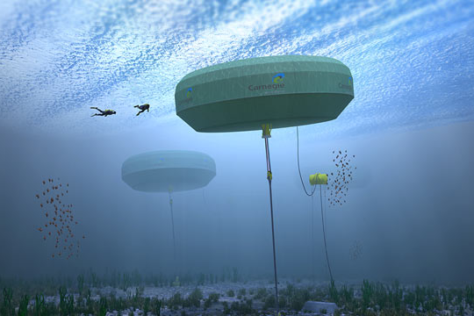
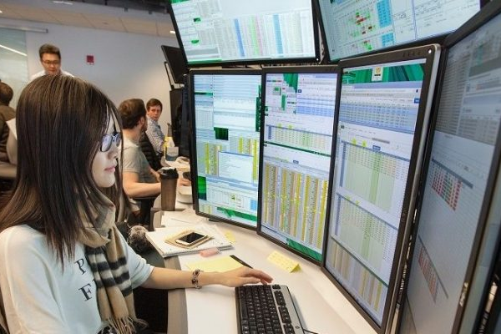
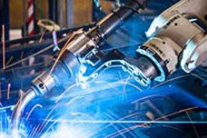
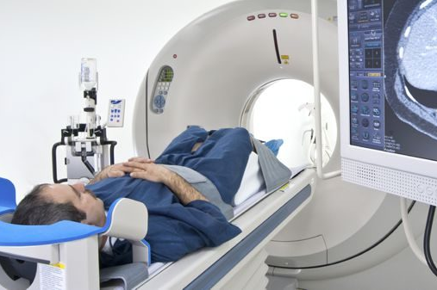
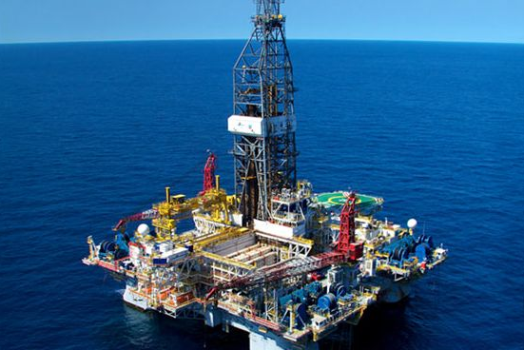
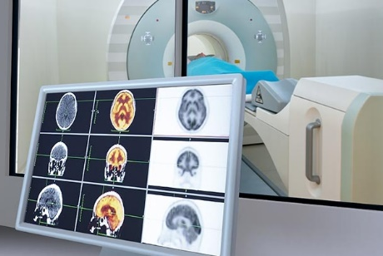
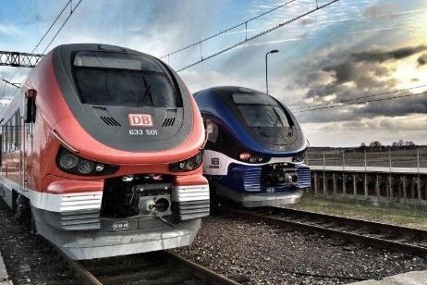

Our Customers / Key Industries
Aerospace and Defense | Automotive | Biological Sciences | Biotech and Pharmaceutical | Communications
Electronics | Energy Production | Financial Services | Industrial Machinery | Medical Devices
Metals, Materials, Mining | Neuroscience | Railway Systems | Semiconductors | Software and Internet
Notes:
All told, our software is used in over 20 industries, from aerospace and automotive, to biotech, energy production, financial services, medical devices, and railway systems.

Slide 7
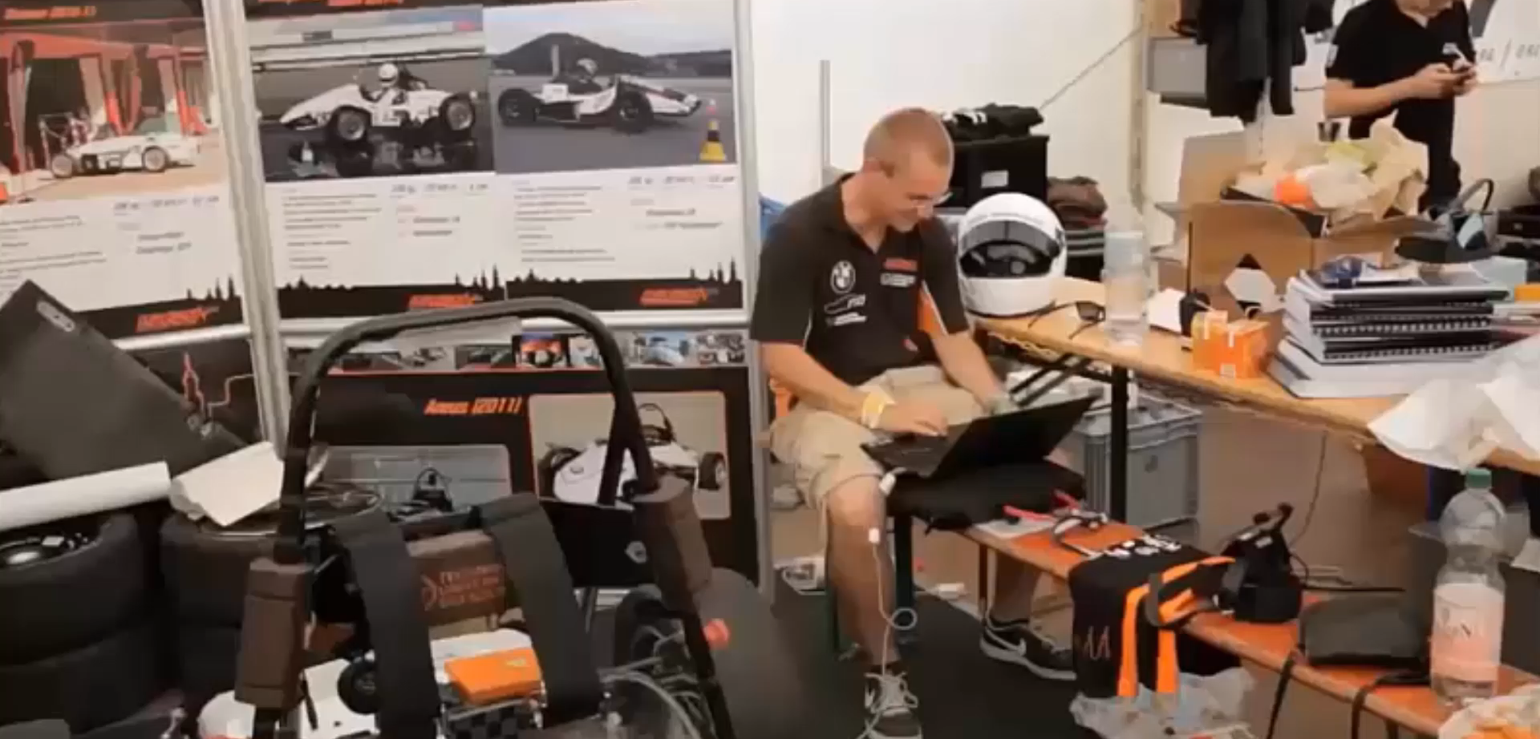
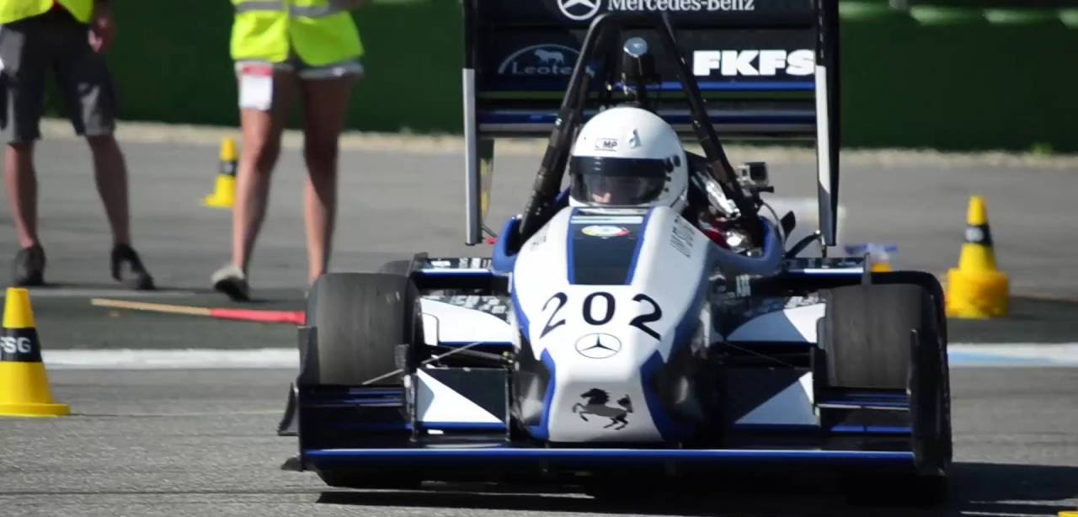
Education / Student Competitions
Sponsored 44 competitions and provided software to 2800 teams in 2020
Fields include automotive, aerospace, biotech, programming, and robotics
Notes:
We also support dozens of student competitions worldwide each year in all kinds of fields, including automotive, aerospace, and robotics
<CLICK TO PLAY VIDEO>
At the Formula Student Germany competition, over 100 teams use our products to simulate strategies, analyze performance, and implement controllers
RoboBoat challenges students to develop a boat that can autonomously navigate through a series of channel markers
And RoboCup is a global competition where students field teams of autonomous robots in simulated soccer matches

Slide 8



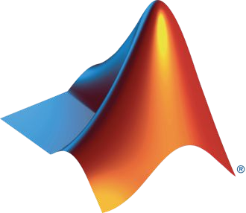
MATLAB and Simulink with Hardware
© 2019 The MathWorks, Inc.
12

Slide 9
Hardware support for MATLAB and Simulink
https://se.mathworks.com/hardware-support/home.html
High level programming
HW models available
You just need to know to code in MATLAB
Compatibility
Automatically converts code to native
Loads all the required drivers
Deployment in several ways
Supports wide range of HW
Support packages and add ons for each HW unit
Real time diagnostics possible
Notes:
MATLAB and Simulink provide support for various hardware tools. Some of them are Arduino, Raspberry Pi, Android, NI and even Intel

Slide 10
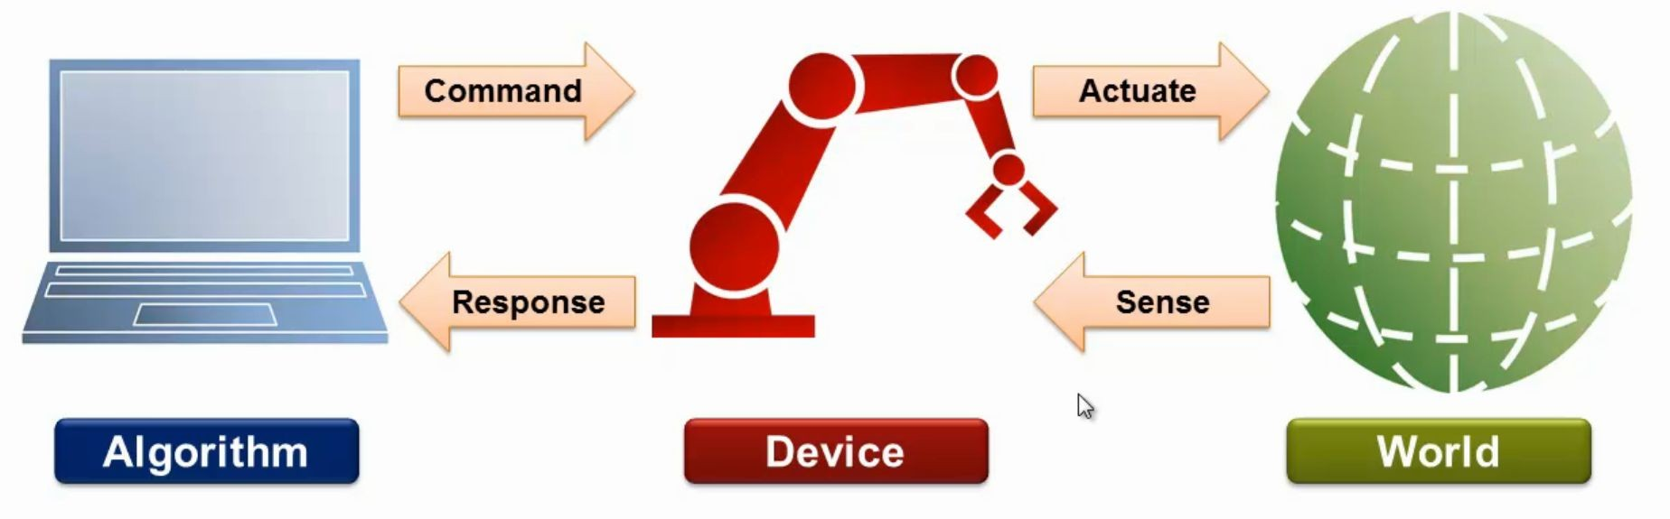
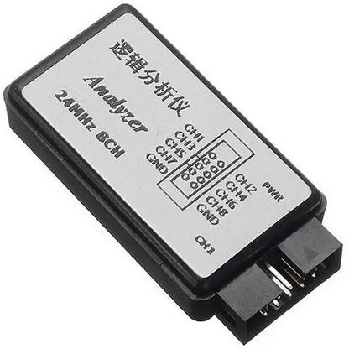
Tethered approach

Slide 11
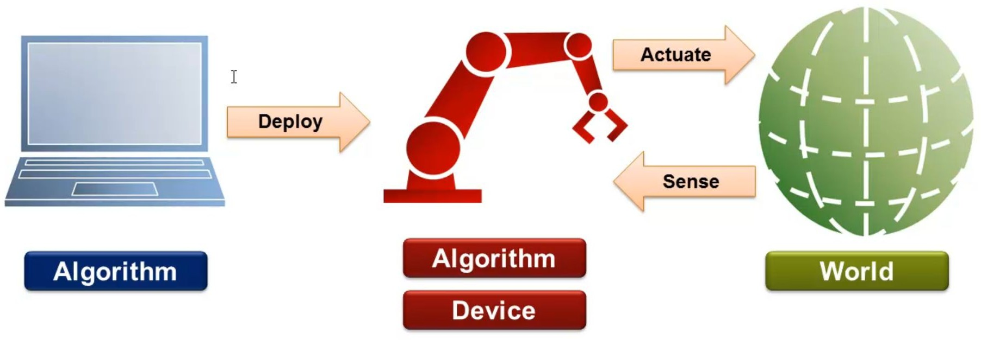
Embedded Approach

Slide 12
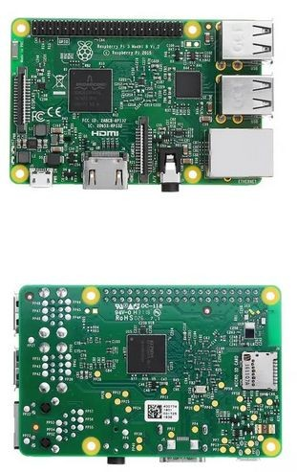
Raspberry Pi Hardware and Software Setup
Quad Core 1.2GHz Broadcom BCM2837 64bit CPU
1GB RAM
Wireless LAN and Bluetooth
x1 Ethernet + x40 GPIO + x4 USB
x1 audio port
CSI camera port for connecting a Raspberry Pi camera
DSI display port for connecting a Raspberry Pi touchscreen display
Micro SD port for loading your operating system and storing data
Micro USB power port

Slide 13
Tutorials and Demos
© 2019 The MathWorks, Inc.
17

Slide 14
What do you need for these demos?
MATLAB
Simulink
MATLAB & Simulink Support package for Raspberry Pi
Computer Vision toolbox
Deep learning toolbox
Deep Learning Toolbox Model for ResNet-50 Network
Audio toolbox
MATLAB Coder
Embedded Coder(for FPGAs and other hardware)

Slide 15
Basic tutorials and demos
LED Blink with MATLAB
Deep learning application with MATLAB using ResNet
Image inversion with Simulink
Text to speech conversion using Simulink
Pitch Shifter with Simulink

Slide 16
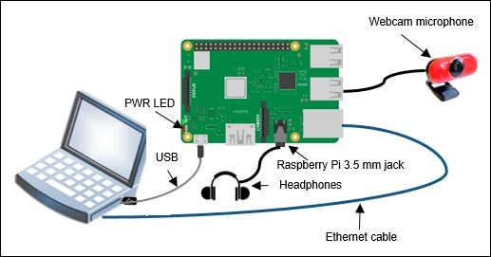

Slide 17
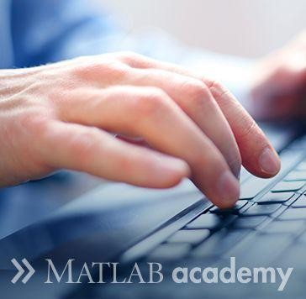
Want to learn MATLAB?
Free access to over 10+ paid courses for Chlamerists
These include
MATLAB for Data Processing and Visualization
MATLAB Fundamentals
MATLAB Programming Techniques
MATLAB for Financial Applications
Machine Learning with MATLAB
Deep Learning with MATLAB
Introduction to Symbolic Math with MATLAB
Solving Nonlinear Equations with MATLAB
Solving Ordinary Differential Equations with MATLAB
Introduction to Linear Algebra with MATLAB
Introduction to Statistical Methods with MATLAB
Sign up to the above courses on
https://matlabacademy.mathworks.com/
Complete at least 50% of any courses listed above and get a free MATLAB goodie bag.

Slide 18
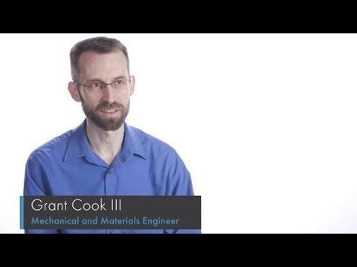
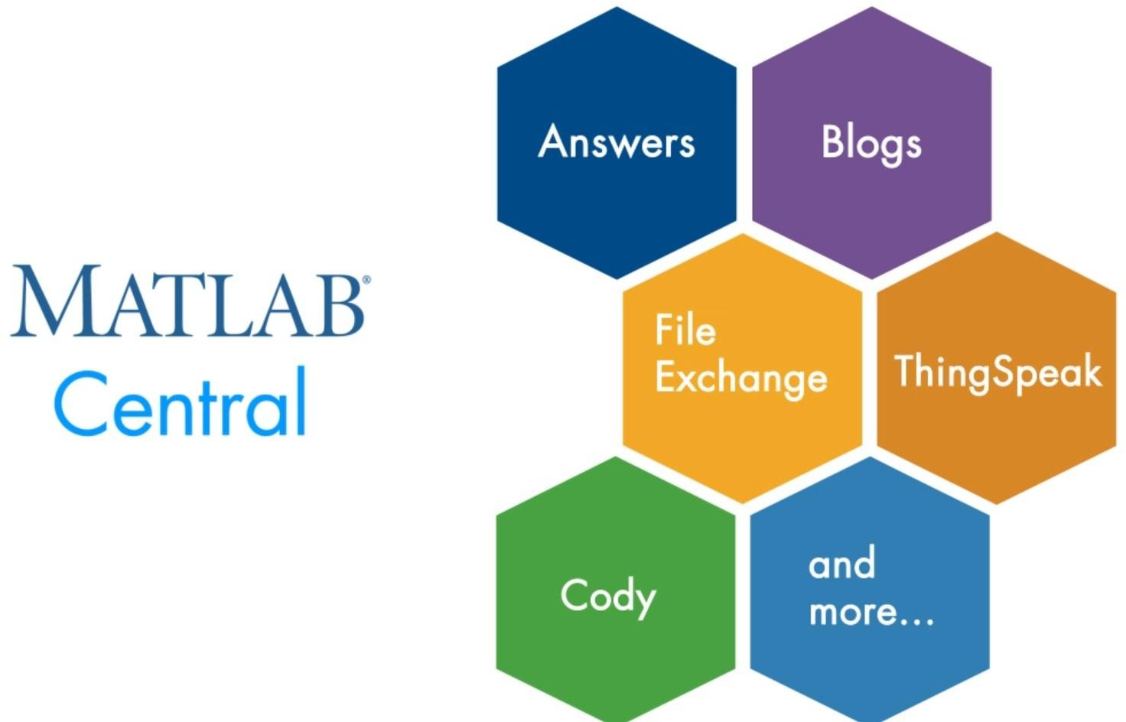
Need help with MATLAB?
Join the MATLAB central community

